Slide 1
Import policies:
dev-veeva-contracts.xml
dev-veeva-customer-contact.xml
dev-veeva-indirect-orders.xml

Slide 2
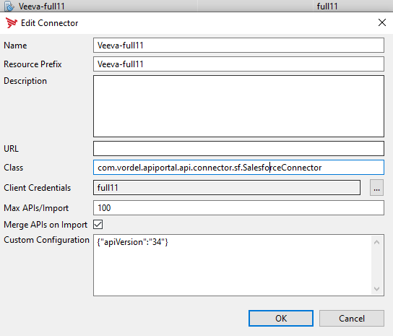
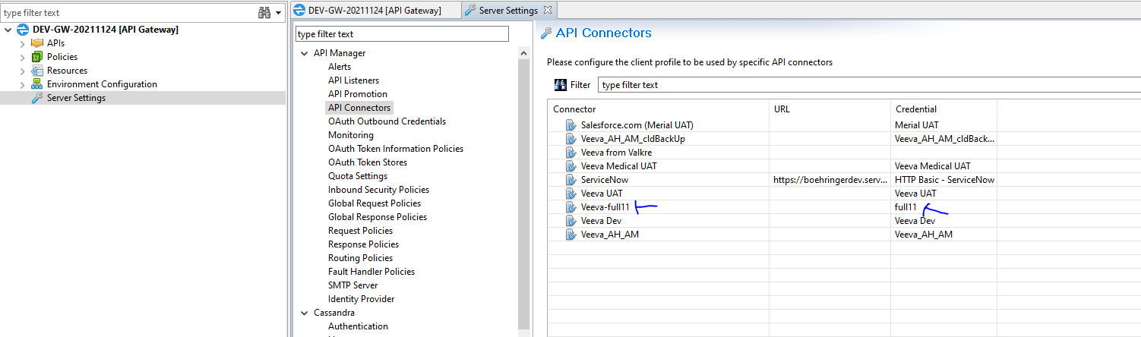
-For Axway connection to Veeva (salesforce), we need some specific configurations after import of the policies :
-server settings → API connectors
-com.vordel.apiportal.api.connector.sf.SalesforceConnector

Slide 3
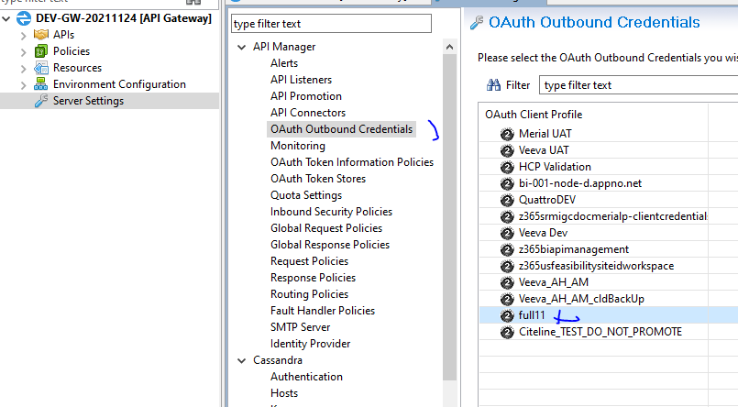
Server settings → oauth outbound credentials

Slide 4
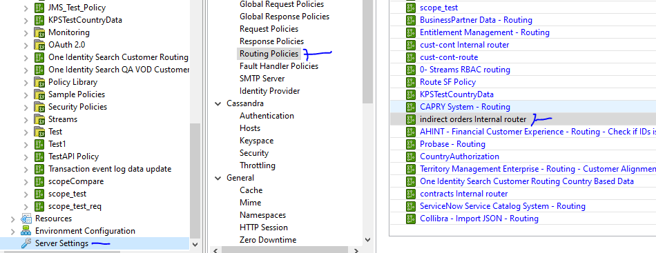
Add to routing policies:
cust-cont Internal router
contracts Internal router
indirect orders Internal router

Slide 5
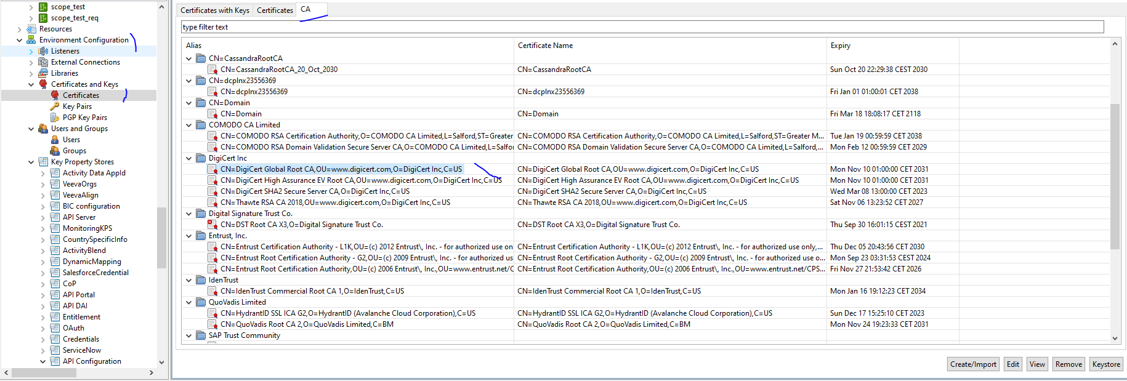
Add certificates authorities : digiCert (create/import) using files:
full11-CA-1.cer
full11-CA-2.cer

